Slide 1
Refactoring Project
Presentation
By
Eric Lin, Jack Corrigan, Moisés Lora, Doanh Pham, Jarrod Cummings, Abdulrahman Alfahad

Slide 2
GUI Refactoring
Description: Firstscreen and Secondscreen both had large amounts of duplicate code, along with a complex conditional statements. In addition, both classes had nested try catch exceptions which reduced code readability.
Evidence: Duplicate Code, Blob Method, Cyclomatic Complexity
Refactorings: Replace exception with test, decompose conditional, extract method
Notes:
Eric: Rationale: Both had big methods, secondscreen’s try catch block was easily replacable, first screen wasnt

Slide 3
Rules Simplification
Description: A simplification of the Rules class, with emphasis on reducing complexity and length of methods.
Evidence: Multiple several hundred line long methods, complex nested conditional statements, repeated code.
Refactorings: Extract methods, decompose conditionals
Notes:
Jack -
YO! ask about checkForMoves code. It seems to just have been deleted with no refactoring to replace it

Slide 4
Checker Piece Decoration
Description: Placed movement responsibilities in checker piece classes. Pieces can be dealt with generically. The methods in King build off of those in Single. Also overlapped with simplifying Rules class.
Evidence: The initial Piece classes did not really serve any purpose beyond holding color and type. There was a lot of type checking in Rules.
Refactorings: Piece classes now handle finding possible moves. King acts as a wrapper for a Single. Complexity of methods in Rules class reduced.
Notes:
Jarrod

Slide 5
State Refactoring
Description: Firstscreen’s actionListener() method contained a large conditional that handled all the functionality of each game mode. This was wrapped in a large try catch block that caught generic exceptions thrown by any of the game modes
Visual Evidence: Nested try catch, large conditional
Refactoring: Replace conditional with strategy (in this case, state)
Each game mode is a new state, handling its own functionality
Notes:
Doanh

Slide 6
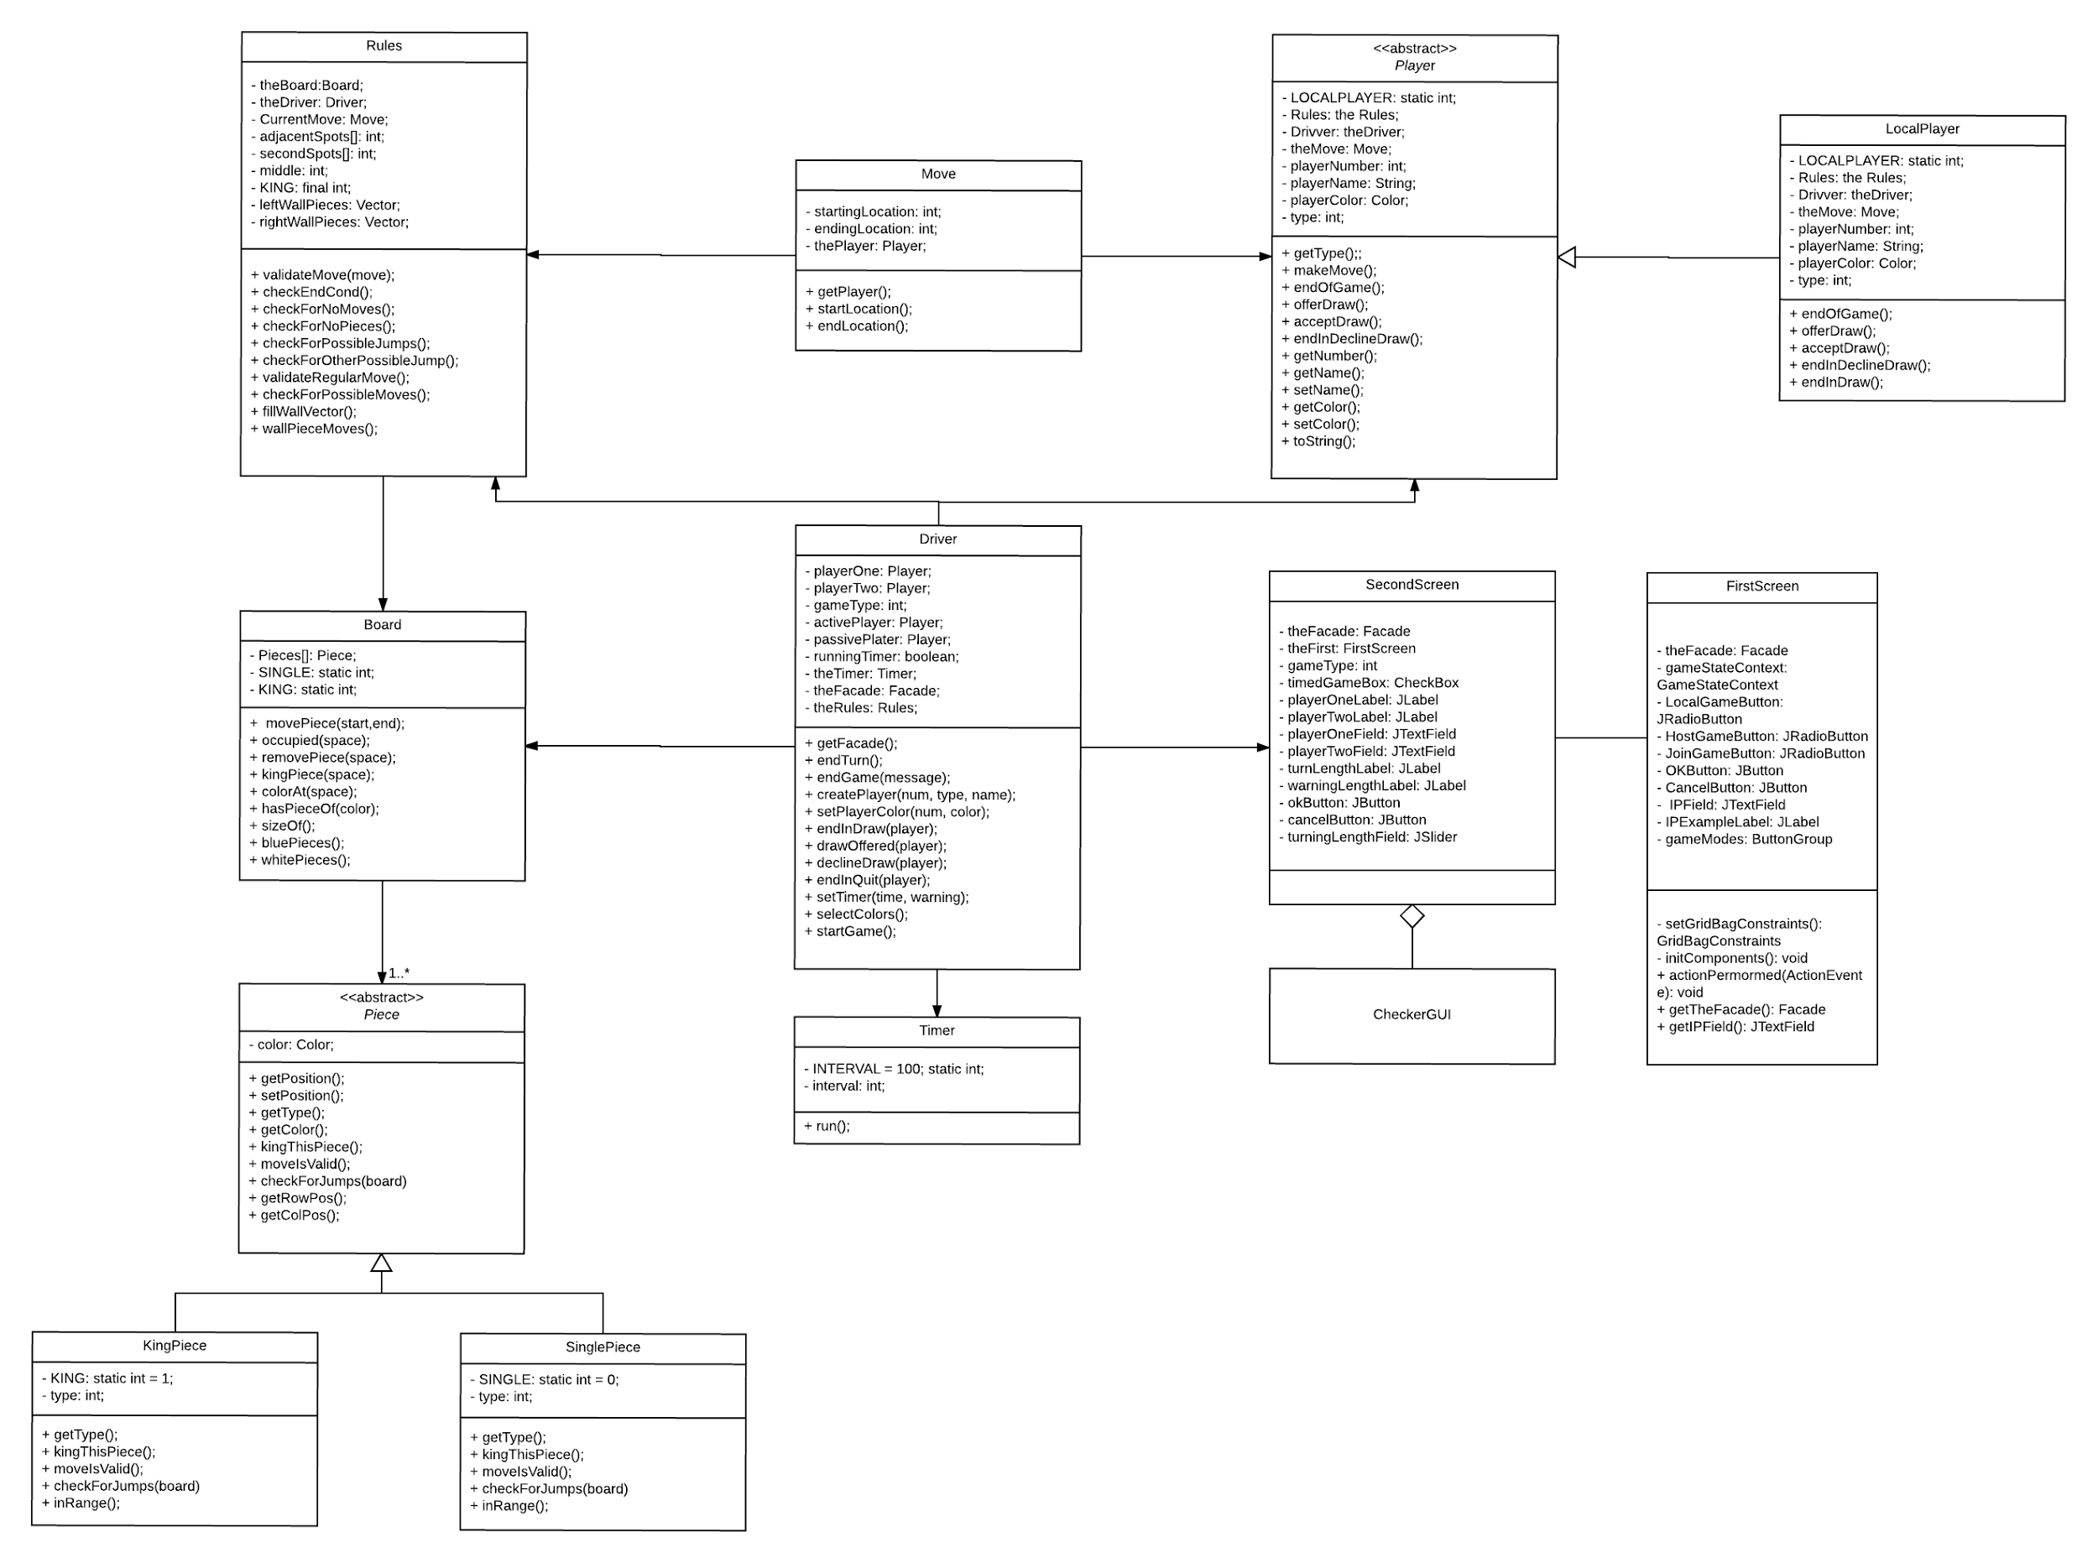
Class Diagram - Old
Notes:
Moises

Slide 7
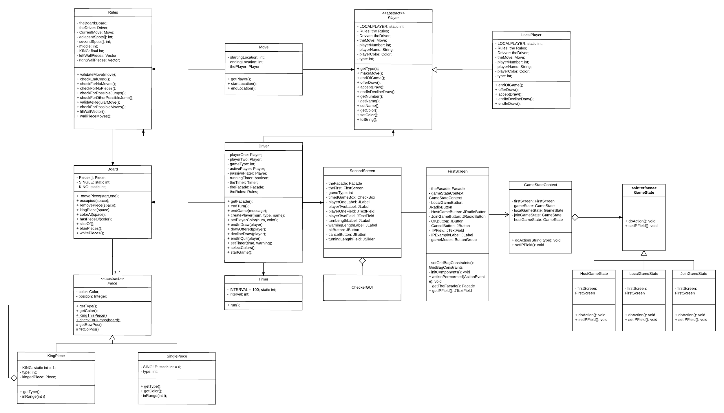
Class Diagram - New
Notes:
Moises

Slide 8
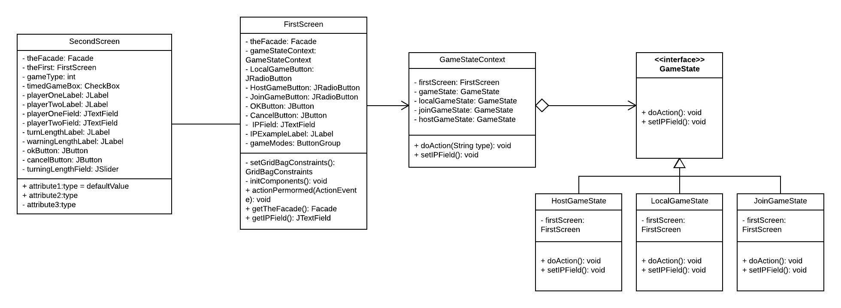

Slide 9
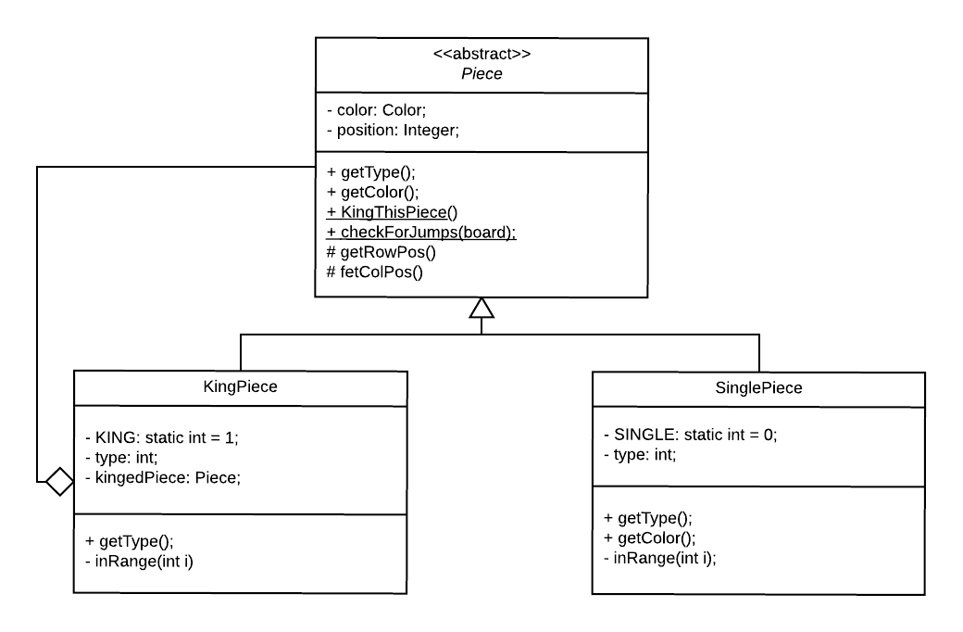

Slide 10
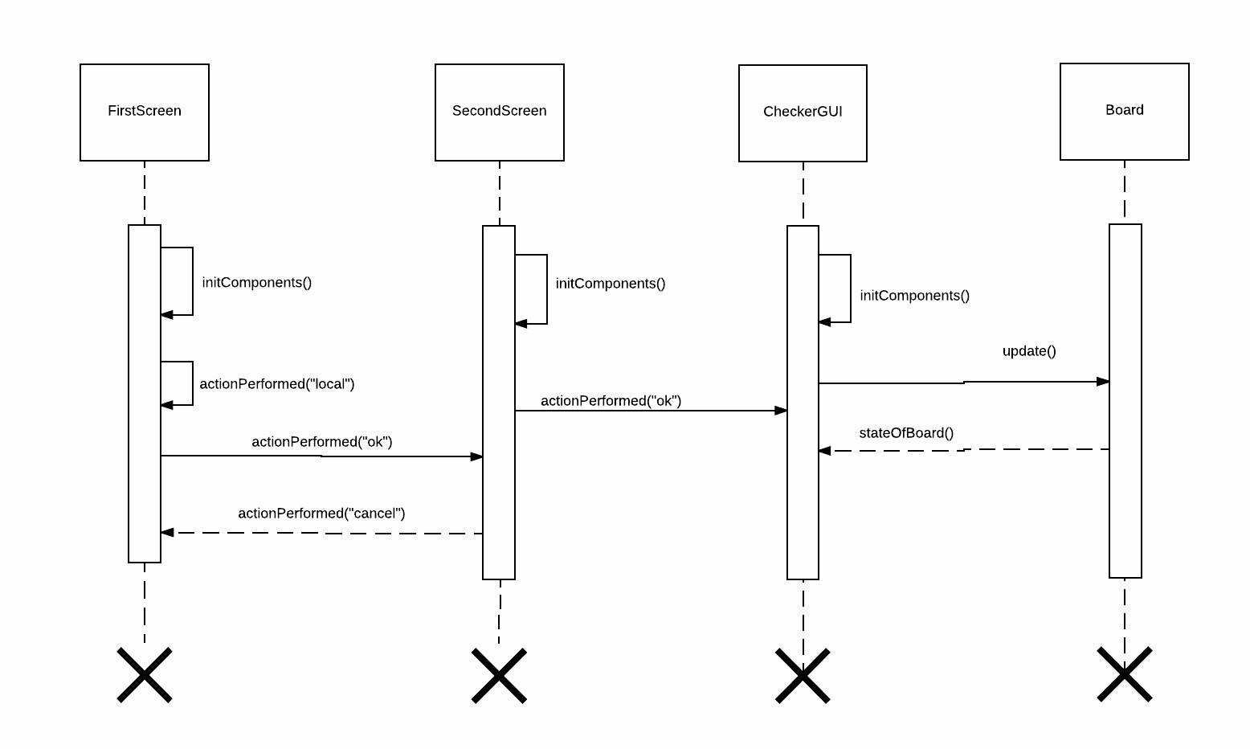
Sequence Diagram 1 - Old

Slide 11
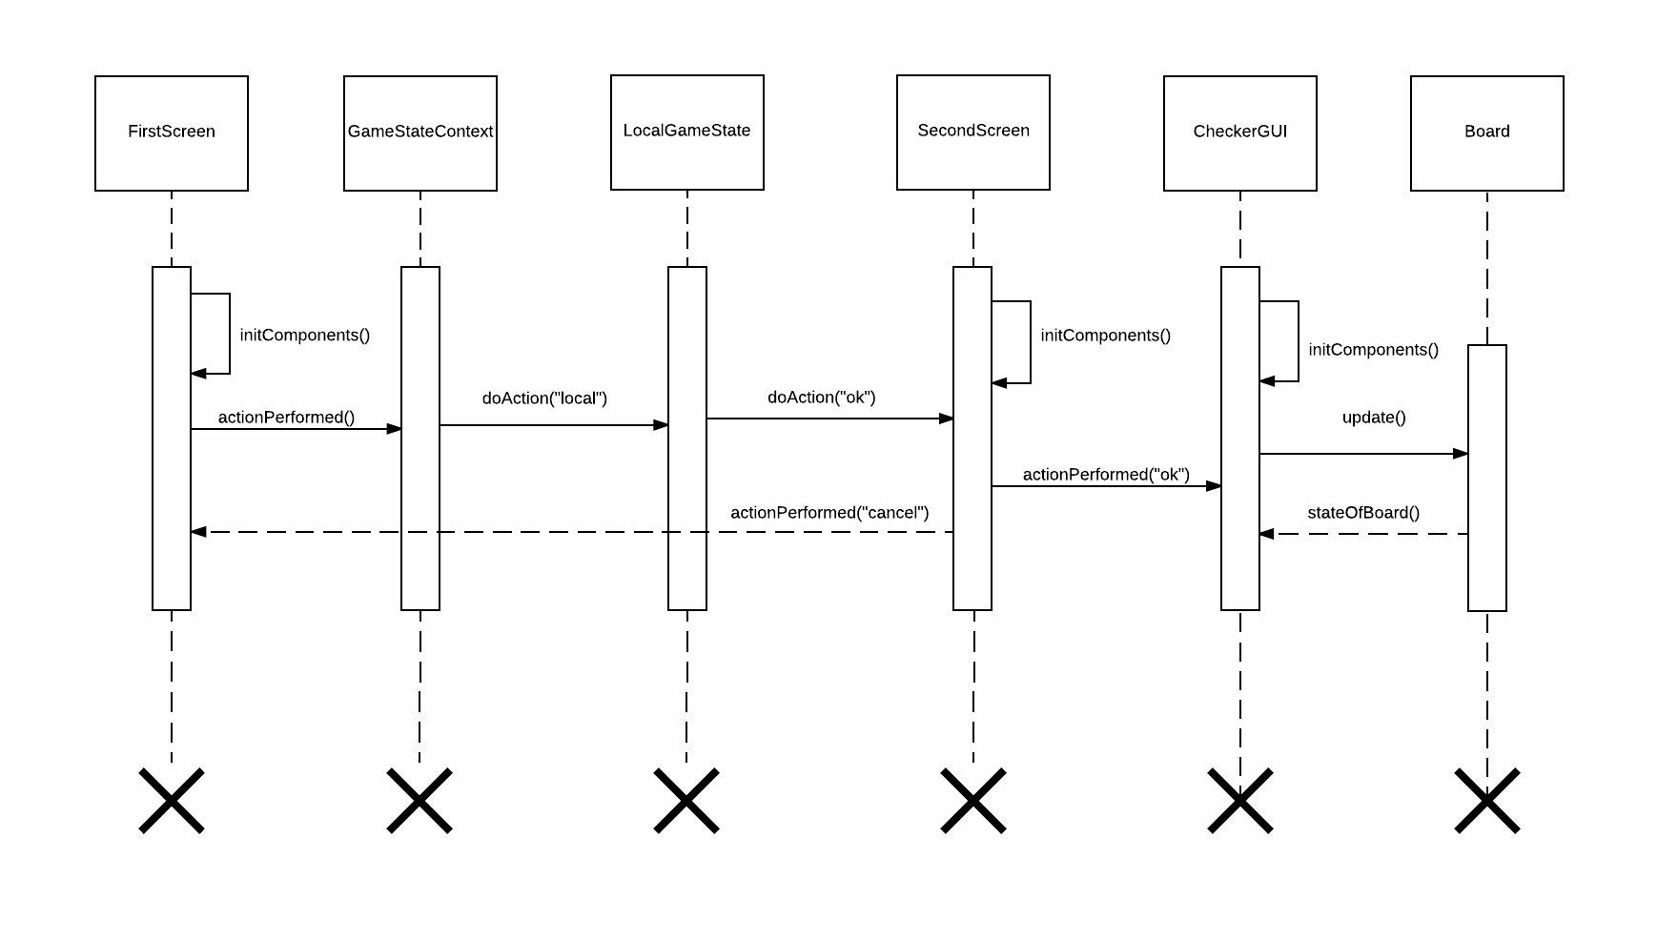
Sequence Diagram 1 - New

Slide 12
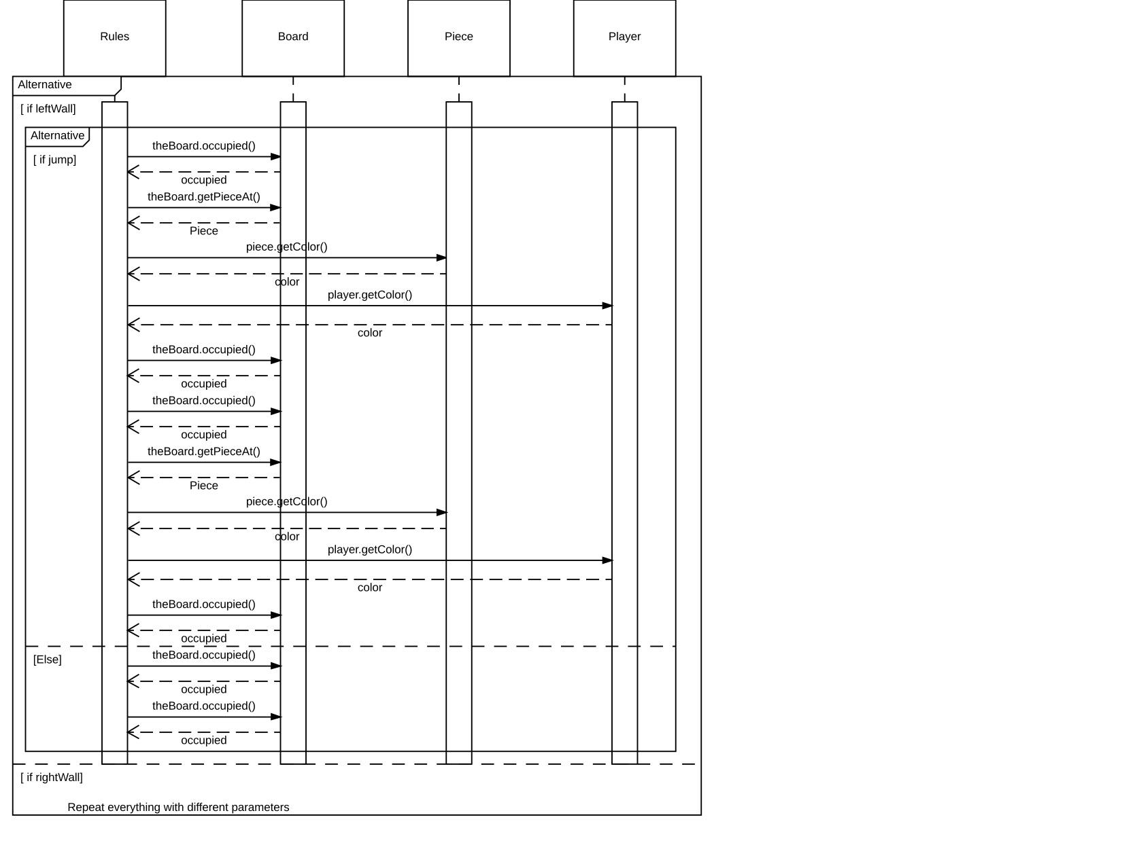
King Piece Wall Move Sequence Diagram - Old
Notes:
Abdul
Point out the duplicated sections that end up as the method calls on the next slide

Slide 13
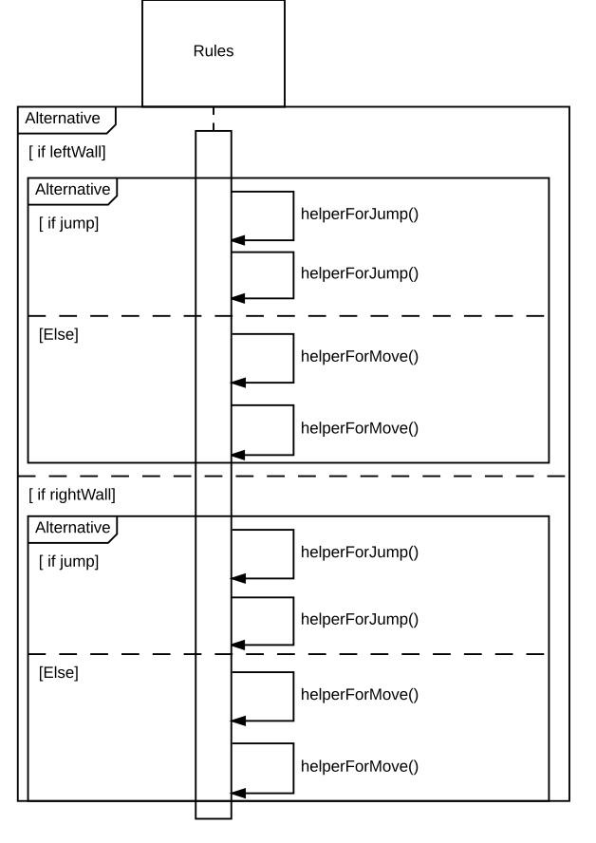
King Piece Wall Move Sequence Diagram - New
Notes:
The primary result of this refactoring was to simplify the Rules class and eliminate duplicate code using the Extract Method technique. As you can see our refactoring significantly lowered the complexity of this section and increased readability. Although helperForJump method still retains similar logic, helperForMove does not need to know about Player and Piece and therefore reduces unnecessary coupling.

Slide 14
Metrics
Cyclic Dependencies: Rules decreased from 27 -> 3 (89% decrease)
Average Coupling Between Objects: (Project) 4.74 -> 5.74 (21% increase)
Lines of Code: 5444 -> 4466 (18% decrease)
Notes:
Eric cyclic dependency: modules that depend on each other

